Slide 1

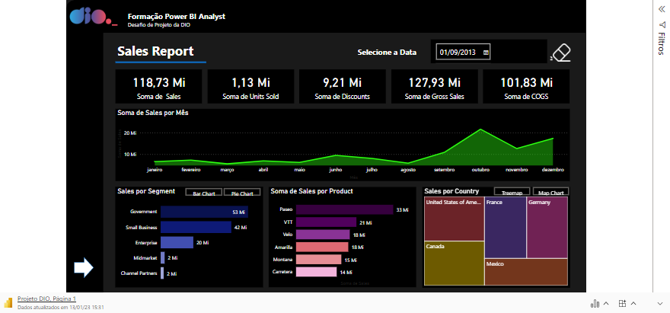
Microsoft Power BI Autor: Israel de Castro Evangelista – Data Scientist and analyst

